Slide 1
Slide 1
northgate
Anchor Meadow Health Centre
Westfield Drive
Aldridge Walsall WS9 8AJ
tel: 01922 450900 fax: 01922 450910
PRACTICE
Dr F E Bolliger, Dr B Sarai, Dr D Gakhal and Dr K Hayer
Seats are separated at 2 meters apart
The room is ventilated
Masks are not mandatory

Slide 2
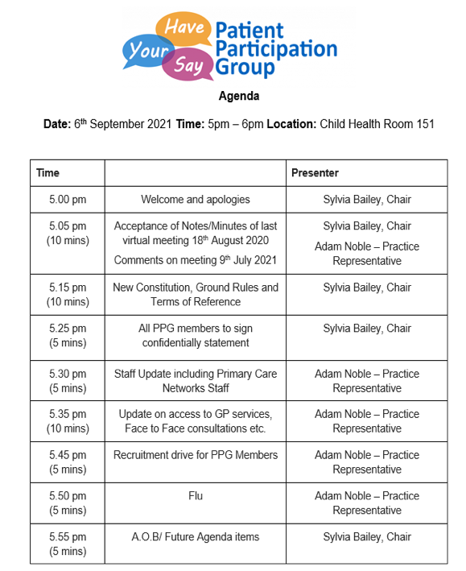
Slide 2

Slide 3
Slide 3
Acceptance of Notes/Minutes of last virtual meeting 18th August 2020 (Please see your handout)
Comments on meeting 9th July 2021(Please see your handout)

Slide 4
Slide 4
New Constitution, Ground Rules and Terms of Reference (Please see your handout)
Does the group agree with these proposed documents?

Slide 5
Slide 5
All PPG members to sign confidentially statement
(Please see your handout, sign and return to Adam during the meeting).

Slide 6
Slide 6
Staff Update
Dr Khattack (Registrar) left January 2021
Dr Nazir joined March 2021
Dr Singal Retired July 2021
Dr Hayer is now a GP Partner
Dr Qureshi (Registrar) joined August 2021
New receptionist – Helen Leech

Slide 7
Slide 7
Primary Care Network Staff Update
Social Prescriber - Michelle Barton & Gurdip Sahota.
Social prescribing is a key component of Universal Personalised Care and is a way for local agencies to refer people to a link worker. Link workers give people time, focusing on ‘what matters to me’ and taking a holistic approach to people’s health and wellbeing. They connect people to community groups and statutory services for practical and emotional support.
Pharmacy Technician - Laura Mayle.
Pharmacy technicians are registered healthcare professionals. The purpose of the role is to maximise safe, cost-effective, prescribing to improve the quality of patient care. They help patients get the best from their medicines,use existing protocols to maximise cost-effective preparations, improve repeat prescribing processes (including use of electronic repeat dispensing and online ordering), minimising
clinical risk and reducing avoidable wasted medicines.
Clinical Pharmacist - Surinderpal Virdee & Ramandeep Aujla.
Clinical Pharmacists provide specialist expertise in the use of medicines, helping to address both the public health and social care needs of patients within a PCN and they help tackle inequalities by helping to improve access to care.

Slide 8
Slide 8
Update on access to GP services, Face to Face consultations etc.
Impact of COVID: The practice were ordered by the Department of Health to completely change the manner of providing services at very short notice, as part of the plan to protect both patients and staff. The practice was mandated to switch to a triage system. The process has had to be adjusted over the last 18 months but the main method of access has been, and still is, eConsult. The pandemic expedited the rollout of eConsult. However we undersatnd this is not ideal as not everyone has access to appropriate equipment/internet etc.
During the height of the pandemic patients were not admitted to the building unless they had been given an appointment; since restrictions have been lifted patients can now enter the building to complete a form to request advice. Access to the building is still controlled to protect vulnerable patients.
One GP (Duty Doctor) now does all the eConsult consultations where as before it war spread over several GPs. This now allows more space for telephone and face to face consultations
The patient will get a response within 24 – 48 hours, but depending on need some responses will be much quicker, for example, recently a patient contacting by telephone was called back within 5 – 6 minutes.
Continued on the next slide.

Slide 9
Slide 9
Update on access to GP services, Face to Face consultations etc.
Currently there are an average of 100 requests each day; these can be managed safely. Following a Bank Holiday weekend earlier in the year there were 170 requests. Last month saw an increase in telephone requests. Use of forms completed in the practice is currently low, patients are not yet aware of this new access method. PPG members could assist with suggesting ways of advertising this approach.
Before the pandemic the waiting time was 2 – 3 weeks for a GP consultation, the wait time has reduced significantly and most things are dealt with within a week. Waiting times to be seen by some senior staff are still 2 – 3 weeks but this is shorter than previously. The ability to get patients to the right person at the right time has increased.
Continued on the next slide.

Slide 10
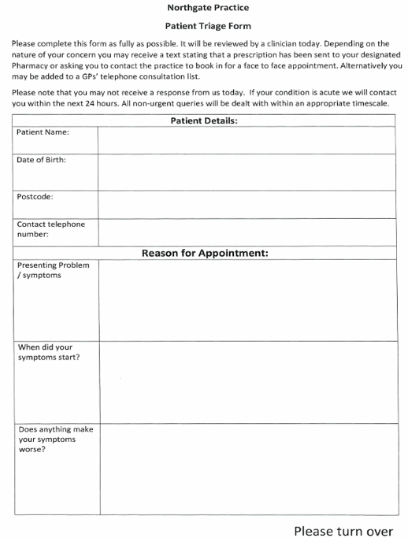
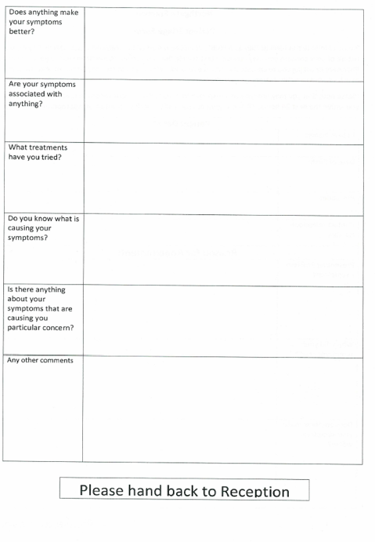
Slide 10
Questions?

Slide 11
Slide 11
Recruitment drive for PPG Members
Group discussion

Slide 12
Slide 12
Flu
Originally NHS England instructed all practices to run flu clinics from central hubs
The reason for this was to give the flu jab along side the covid booster
There has been a delay getting the covid booster and practices will now do some flu clinics in practice
Details about covid boosters will become available soon, practice websites will be updated with the information when its released to practices
The first flu clinic is Saturday 11th September 8am-11am at the practice.
Volunteers will be required for the flu clinics

Slide 13
Slide 13
A.O.B/ Future Agenda items
GP patient survey results 2021
Reviewing complaints/feedback
Promoting eConsult – design posters, speaking to patients in house
Promoting the practice website - design posters, speaking to patients in house
Looking at areas of interest ie diabetes, mental health
A focus board (in front of the TV in the waiting room)
Newsletter
Suggestion Box

Slide 14
Slide 14
Next meeting date? TBC

Slide 15
Slide 15
Thank you for attending

