Slide 1
Northgate Practice Patient Participation Group
Northgate Practice
Patient Participation Group
Northgate Practice
Patient Participation Group
Meeting will begin soon

Slide 2
Slide 2
Northgate Practice
Patient Participation Group Virtual Meeting Tuesday 18th August 1-1.30pm
Janet Jukes to take minutes as usual please so they can be displayed on the website.
AGENDA
Practice Update - Staff
Primary Care Access during Covid-19
Flu clinics 2020
Social Prescriber
First Contact Physiotherapist
Future for patient group
A.O.B

Slide 3
Slide 3
Practice Update - Staff
Dr Lloyd retired January 2020 – she thanked ther PPG in her farewell speech.
Dr Makam Registrar left January 2020 and has been replaced by Dr Khattack (Male)
2 new GPs – Dr Gupta (Female) & Dr Kyranides (Female)
Chris Blunt is due to retire as Portland Manager at the end of August 2020 and to remain as Northgate Manager for the time being.
QUESTIONS?

Slide 4
Slide 4
Primary Care Access during Covid-19
Media coverage has been poor nationally on how general practice is working through the pandemic, some people think were closed!
General Practice is working but in a very different way.
Below are a few examples on how were working and looking after our patients.

Slide 5
Slide 5
NO ROUTINE FACE TO FACE APPOINTMENTS
eConsult – On average 400 eConsults are submitted each week and a patient submits an eConsult through the practice website. Before the pandemic we were receiving on average of 40 a week. Patient outcome – email back, telephone consultation or face to face consultation if clinically necessary.
eConsult Lite - If a patient cannot do an eConsult or does not have access to the internet they can call the practice and a receptionist will ask them some questions and will be booked in for a telephone consultation. These questions have been developed by a team of GPs.
Accurx – Accurx is a text based system where the GPs and nurses can text a patient directly from their computer. For example, if the clinician has requested a video consultation they will send you the invite to your appointment via text and you click on the link in the text message or the clinician can send you some information about talking therapies or diabetes…the list goes on!
Some normal services have resumed – Smears, Diabetic check, dressings, Asthma check, some injections.
QUESTIONS?

Slide 6
Slide 6
Flu clinics 2020
Saturday flu clinics start 12th September.
Appointments available now
We will be doing more Saturdays as we cannot have the normal number in the building as we normally would. We will be holding some day clinics (TBC)
Name and temperature taken at the door.
The practice has decided not to ask the PPG this year as this would be putting members at an unnecessary risk.
QUESTIONS?

Slide 7
Slide 7
Social Prescriber
Nicola works for Walsall East two PCN which includes, Blackwood Health Centre, Collingwood Family Practice, Northgate Practice, Portland Practice, Rushall Medical Centre.
QUESTIONS?

Slide 8
Slide 8
First Contact Physiotherapist
Northgate Practice are trialling a new system for the PCN.
Bone, Joint or Muscle Pain?
The First Contact Physiotherapist will –
• Assess you and diagnose what’s happening
• Give expert advice on how best to manage your condition
• Recommend exercises and other approaches to deal with the issue
• Refer you on to specialist services if necessary
A National evaluation on this service showed
• Faster access to specialist expertise
• Fewer onward referrals to see a hospital consultant
• On average, 95% of patients do not require a GP follow-up

Slide 9
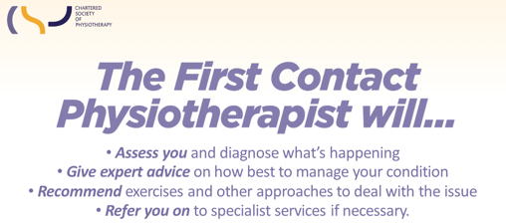
Slide 9
Telephone Only
Will be seen at the health centre if clinically necessary
QUESTIONS?

Slide 10
Slide 10
Future for patient group
Meetings will be held virtually for the foreseeable future
This may gain interest from younger members.
QUESTIONS?

Slide 11
Slide 11
A.O.B

Slide 12
Slide 12
Thank you
Next meeting date TBC

